Slide 1

Database Management System
Lecture 2
ENGR. DR SAIMA WASEEM
SCHOOL OF SYSTEMS AND TECHNOLOGY (SST)
ARTIFICIAL INTELLIGENCE FACULTY

Slide 2
Database Schema vs. Database State (continued)
Distinction
  The database schema changes very infrequently.
  The database state (Instance) changes every time the database is updated.
Schema is also called intension.
State is also called extension.

Slide 3

Example of a Database Schema

Slide 4

Example of a database state

Slide 5

Typical DBMS Component Modules
Slide 2- <number>

Slide 6
Centralized and Client-Server DBMS Architectures
Centralized DBMS:
  Combines everything into single system including- DBMS software, hardware, application programs, and user interface processing software.
  User can still connect through a remote terminal – however, all processing is done at centralized site.

Slide 7

A Physical Centralized Architecture

Slide 8
Basic 2-tier Client-Server Architectures
Specialized Servers with Specialized functions
  Print server
  File server
  DBMS server
  Web server
  Email server
Clients can access the specialized servers as needed

Slide 9

Logical two-tier client server architecture

Slide 10
Clients
Provide appropriate interfaces through a client software module to access and utilize the various server resources.
Clients may be diskless machines or PCs or Workstations with disks with only the client software installed. User interfaces and application programs moved to client side
Connected to the servers via some form of a network.
  (LAN: local area network, wireless network, etc.)

Slide 11
DBMS Server
Provides database query and transaction services to the clients
Relational DBMS servers are often called SQL servers, query servers, or transaction servers. Query and transaction facilities
Applications running on clients utilize an Application Program Interface (API) to access server databases via standard interface such as:
  ODBC: Open Database Connectivity standard
  JDBC: for Java programming access
Client and server must install appropriate client module and server module software for ODBC or JDBC

Slide 12
Two Tier Client-Server Architecture
A client program may connect to several DBMSs, sometimes called the data sources.
In general, data sources can be files or other non-DBMS software that manages data.
Other variations of clients are possible: e.g., in some object DBMSs, more functionality is transferred to clients including data dictionary functions, optimization and recovery across multiple servers, etc.
Simplicity and compatibility are the two advantages of two-tier architecture.
Slide 2- <number>

Slide 13
Three Tier Client-Server Architecture
Common for Web applications
Intermediate Layer called Application Server or Web Server:
  Stores the web connectivity software and the business logic part of the application used to access the corresponding data from the database server. Rules, accept request, process request, and send request to server.
  Acts like a conduit for sending partially processed data between the database server and the client.
Three-tier Architecture Can Enhance Security:
  Database server only accessible via middle tier
  Clients cannot directly access database server
Slide 2- <number>

Slide 14

Three-tier client-server architecture
Slide 2- <number>

Slide 15
Introduction to ER Model
• ER model is a high-level conceptual data model.
• Used in database design to define data elements and relationships.
• Introduced by Peter Chen in 1976.
• Visualizes entities, attributes, and relationships in a system.

Slide 16
Terminologies
★ Entity:
• A “thing” in the real world with an independent existence.
• May be an object with physical existence (ex: house, person)
or with a conceptual existence (ex: course, job).
★ Attributes:
• Properties that describe the entities.
CF

Slide 17
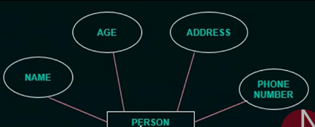
CF

Slide 18
Composite vs. Simple Attributes
Feature | Composite Attribute | Simple Attribute
Divisibility | Can be split into sub-attributes | Cannot be split
Information Depth | More detailed (hierarchical structure) | Atomic (flat structure)
Example | Name → First, Middle, Last | Age, Salary
Notation | Ellipse with branches for subparts | Single ellipse

Slide 19
Basic Concepts: ER Model – Attributes
Single-Valued Attributes
These are attributes that hold only one value for each entity instance.
Example:
  A person’s Age or Email is typically a single value.
Notation in ER Diagram:
  Represented by a simple ellipse connected to the entity.
CF

Slide 20
Basic Concepts: ER Model – Attributes
Multi-Valued Attributes
These are attributes that can hold multiple values for each entity instance.
Example:
  A person might have multiple Phone Numbers or Degrees.
Notation in ER Diagram:
  Represented by a double ellipse connected to the entity.
CF

Slide 21
Feature | Single-Valued Attribute | Multi-Valued Attribute
Value Count | One value per entity instance | More than one value allowed
Diagram Notation | Single ellipse | Double ellipse
Examples | Age, Gender | Phone Numbers, Email Addresses
Database Mapping | Maps to single column | Requires a separate relation/table
CF

Slide 22
Stored Attributes
These are explicitly stored in the database.
Represent the actual, physical data values kept in the system.
Example:
  Date_of_Birth, Employee_Salary, Email
✅ Used when the value needs to be persistently stored.
ER Notation:
  Represented with a regular ellipse.
CF

Slide 23
Derived Attributes
These are not stored directly, but rather calculated or derived from stored attributes.
Example:
  Age can be calculated from Date_of_Birth
  Total_Price can be calculated as Unit_Price × Quantity
✅ Used to avoid redundancy and to maintain consistency.
ER Notation:
  Represented using a dashed ellipse.
CF

Slide 24
Feature | Stored Attribute | Derived Attribute
Stored in DB? | Yes | No
Updated manually? | Yes (directly updated) | No (calculated when needed)
Redundancy Risk | Possible | No redundancy
Example | Date_of_Birth, Email | Age (from DOB), Total Salary (basic+DA)
ER Notation | Regular ellipse | Dashed ellipse
CF

Slide 25
What Are Complex Attributes?
Definition: A complex attribute is an attribute that combines multi-valued and composite attributes.
It represents a hierarchical structure in the ER model, where:
  An attribute is made up of several components (composite),
  And each component can have multiple values (multi-valued).
CF

Slide 26
Example
Let’s say we have a Contact_Info attribute:
It includes:
  Phone Numbers (multi-valued)
  Email addresses (multi-valued)
  Address → Street, City, ZIP (composite)
Thus, Contact_Info is a complex attribute because it includes:
Multi-valued sub-attributes (Phone, Email)
Composite sub-attributes (Address)
CF

Slide 27
NULL Type in DBMS
NULL represents a missing, unknown, or inapplicable value in a database.
It does not mean zero (0) or an empty string ("").
It is a placeholder indicating that no value has been assigned.
NULLs are used when:
Data is not yet known (e.g., someone's Phone Number not provided yet).
Data is not applicable (e.g., a Spouse Name for an unmarried person).
Data is intentionally withheld or not collected.
CF

Slide 28
Attribute | Value | Explanation
Age | 25 | Known and stored
Spouse_Name | NULL | Person is unmarried
Phone_Number | NULL | Not yet provided by the user
CF

Slide 29
Entity Type
Definition: An entity type is a category or blueprint for a group
of objects (entities) that share the same attributes.
It defines a schema or structure.
Think of it as the template for the entities.
Example:
STUDENT is an entity type defined by attributes like:
  Student_ID, Name, Department, DOB.
CF

Slide 30
Entity Set
Definition: An entity set is a collection of all entities (records) of a given entity type at a particular point in time.
It is the actual data or the population of instances.
🔍 Example:
Student_ID | Name | Department | DOB
101 | Ayesha | CS | 2001-02-12
102 | Ali | EE | 2000-06-18
103 | Sara | ME | 2002-03-22
CF

Slide 31
Key Attributes in ER Model
🔹 Definition
A key attribute is an attribute (or a combination of attributes) that uniquely identifies each entity in an entity set.
It ensures uniqueness — no two entities have the same value for the key attribute(s).
Entity Type | Key Attribute | Other Attributes
STUDENT | Student_ID | Name, Department, DOB
EMPLOYEE | Employee_Number | Name, Position, Salary
BOOK | ISBN | Title, Author, Publisher
CF

Slide 32
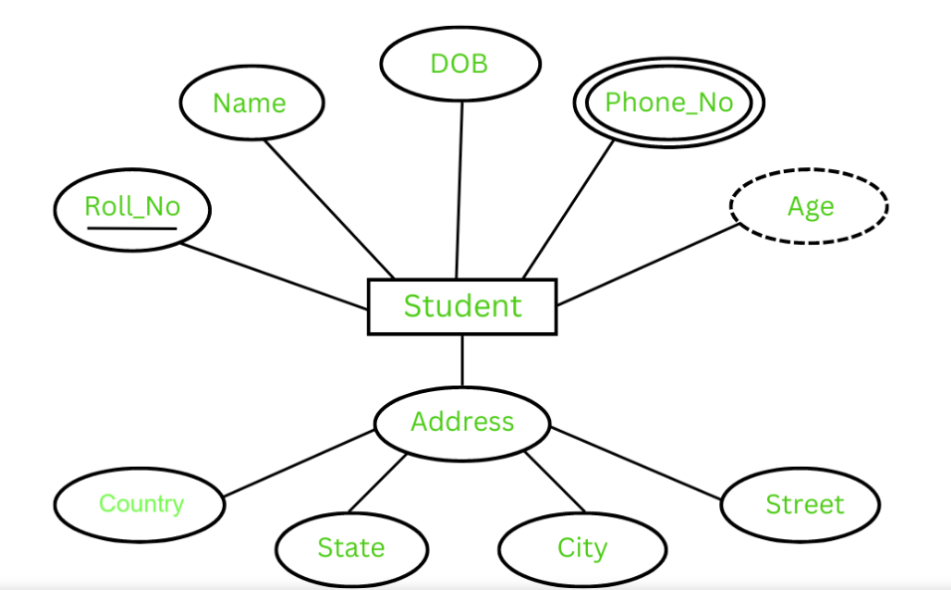
CF

Slide 33
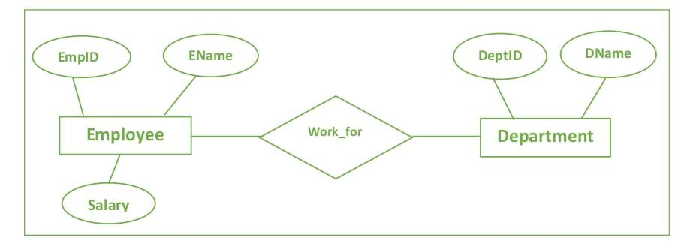
CF

Slide 34
Database Design Process
The database design process consists of multiple stages:
1. Requirements Analysis
2. Conceptual Design (ER Modeling)
3. Logical Design (Normalization, Schema Mapping)
4. Physical Design (Indexes, Storage Structures)
5. Implementation and Maintenance

Slide 35
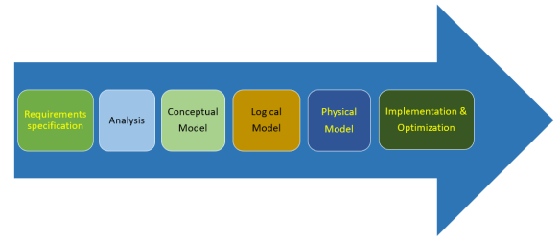
CF

Slide 36
1. Requirements Analysis
• Understand the data needs of the organization.
• Identify key entities, attributes, and relationships.
• Document use cases and business rules.
• Final output: A requirement specification document.

Slide 37
2. Conceptual Design
• Concise and brief requirement of datatype and detailed description about entities, relationships and constraints.
• Define entities, attributes, and relationships.
• Identify key attributes and constraints.
• Output: ER model representing system at high level.
It does not contain implementation details. It is easier to understand and can be communicated easily with the nontechnical users

Slide 38
3. Logical Design
Convert ER diagrams to relational schema.
Apply normalization (1NF, 2NF, 3NF).
Define primary, foreign keys, and integrity constraints.
Output: Logical schema ready for a specific DBMS.
Implemented in Microsoft SQL servers Oracle

Slide 39
4. Physical Design
Decide on storage structure and access methods.
Create indexes and partitions.
Optimize performance and storage.
Output: DB-specific physical implementation plan.
Application program is designed to process transactions

Slide 40
Entity Types in ER Model
Strong Entity Type (Regular Entity)
Definition: An entity that can be uniquely identified by its own attributes.
Has its own primary key (unique identifier).
Does not depend on any other entity for identification.
Example:
STUDENT with attributes:
  Student_ID (Primary Key), Name, Department
CF

Slide 41
Weak Entity Type
Definition: An entity that cannot be uniquely identified by its attributes alone.
Depends on a strong entity (called the identifying/owner entity).
Uses a partial key (discriminator) + the primary key of the related strong entity.
Always has a total participation in the identifying relationship.
Example:
DEPENDENT of an EMPLOYEE, with attributes:
  Dependent_Name (partial key), Age, Relationship
  Needs Employee_ID (from EMPLOYEE) to form a unique identifier.
CF

Slide 42
Feature | Strong Entity Type | Weak Entity Type
Identification | Has a full primary key | Uses a partial key + strong entity's key
Dependency | Independent | Dependent on a strong entity
ER Diagram Representation | Single rectangle | Double rectangle
Key Attribute | Fully underlined | Partial key: dashed underline
Participation | May be partial | Always total in identifying relationship
Relationship Requirement | May or may not be present | Must have identifying relationship
Example | STUDENT, EMPLOYEE | DEPENDENT (of EMPLOYEE), ORDER_ITEM (of ORDER)
CF

Slide 43
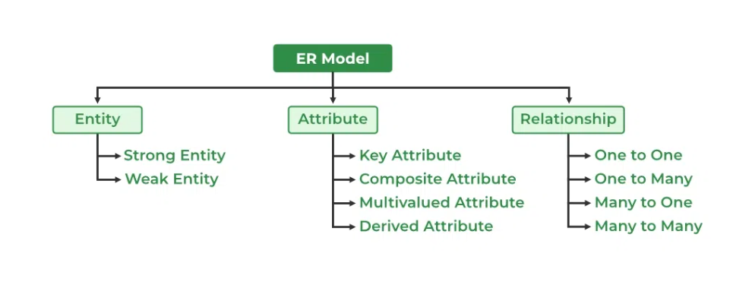
CF

Slide 44
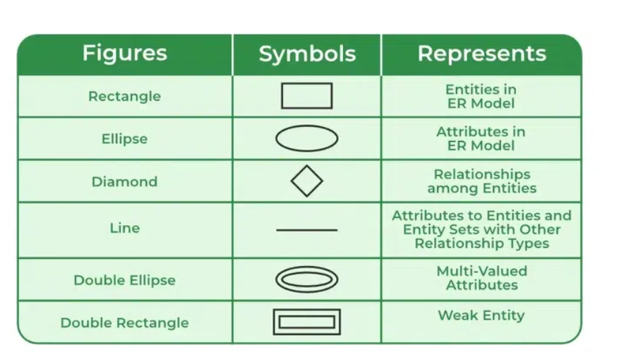
CF

